Slide 1
SALON MANAGEMENT
MINOR PROJECT PRESENTATION

Slide 2
TEAM MEMBERS :- HARSH CHAUHAN HARSH AWASTHI
PROJECT SUPERVISOR:
MS SHALIKA ARORA (Asst. Professor)

Slide 3
INTRODUCTION:
Welcome to our presentation on the salon management system,
A revolutionary new software designed specifically for salon owners
Looking to streamline their operation and improve customer service. With the salon management system , you’ll be able to manage appointments , track
Inventory , and provide personalized service to your customers like never before.

Slide 4
OBJECTIVE
Today internet and its boom had created a new economic scenario that not only stresses
on classical concept of “Product” but also the modern concept of “Services”.
The main objective of saloon management system is to save time and reduce the complexity of work at saloon.
The objective of this project is to – Eliminate the paper based work used at the saloon premises.
Eliminate the data redundancy: keeping appointments details at several places (Diary, mobiles etc)
Improves Client and Employee satisfaction
Enhance the stakeholder integration

Slide 5
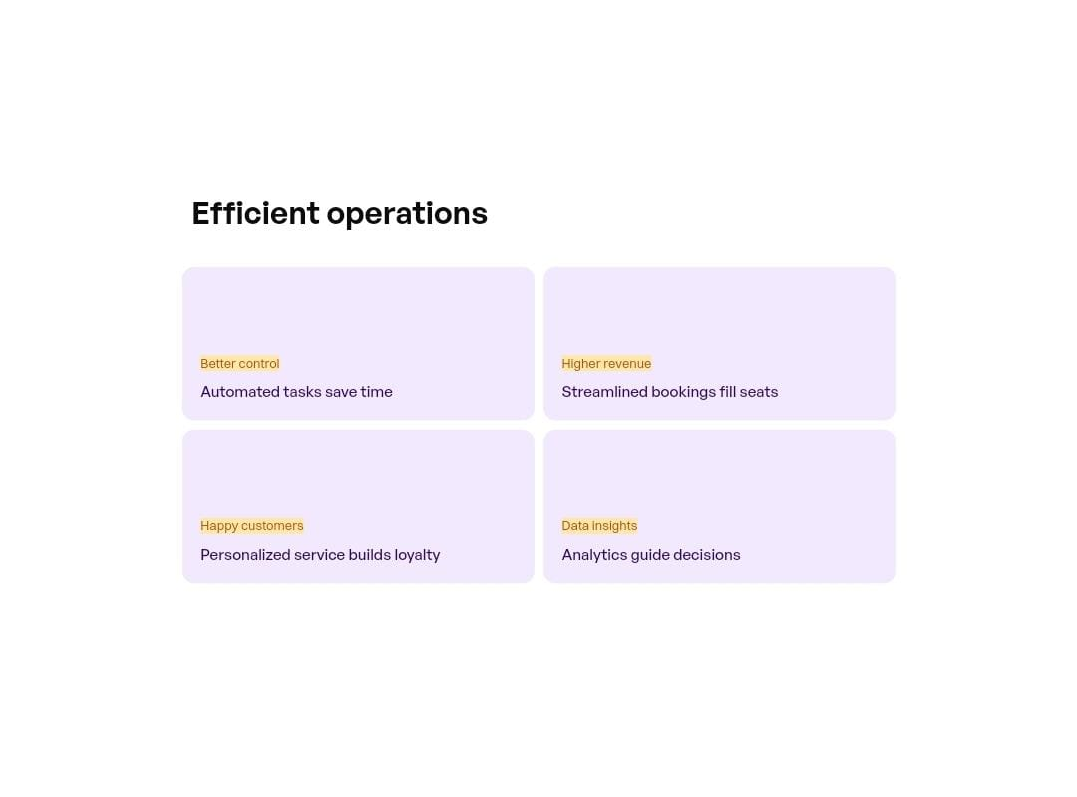

Slide 6
TECHNOLOGIES
Client Side Framework
Backend And Database
Frontend Design
HTML Structure pages, CSS styles, JavaScript behaviors
React builds user interface components
Node.js Application logic
MySQL Stores Application Data

Slide 7
MODULES
Service Modules
Dashboard Module
Customers Module
Appointments Module
Products Module
Notification Module

Slide 8
FUNCTIONAL REQIREMENTS :-
USER MANAGEMENT
Registration and login for salon staff (admin, stylist, receptionist)
User roles and permission management
APPOINTMENTS SCHEDULING
Online Appointment booking for customers
Stylist availability and appointment scheduling
Real time synchronization for appointments
CUSTOMER MANAGEMENT
Customer profiles with contact information and appointments history
Record Customer preferences (eg. Favorite stylist, preferred services)
STAFF MANAGEMENT
Stylist profile with information on skills , availability , and schedules
Staff scheduling and shift management
Performance tracking

Slide 9
FUNCTIONAL REQIREMENTS :-
5. POINT OF SALE (POS)
Process payments for services and products
Generate invoices and receipt
Integration with payment gateways
6. REPORTING AND ANALYTICS
Generate reports on appointment bookings , revenue, and staff performance
Tracking Inventory usage and sales
7. CUSTOMER FEEDBACK AND REVIEWS
Collect and manage customers feedback and reviews
Allow customers to rate and review services

Slide 10
CONCLUSION:
In conclusion , the salon management system is a game changer for salon owners who want to streamline their business operations and provide better service to their customers.
By adopting this system , salon owners can enjoy benefits such as increased efficiency , improved customers service , and better business insights.
Customers will also benefits from easier appointment scheduling , personalized service , and faster checkouts.
With a well planned implementation strategy and a smart investment in the system , salon owners can expect a significant return on investment in the long run.

Slide 11
THANK YOU!

